Slide 1
The Impact of Recent Inflation on Wage Growth In US
Presented by: Luke Alati, Rand Aldawish, Geoff Feinstein, Sizhe Liu, Ibukun Kolade

Slide 2
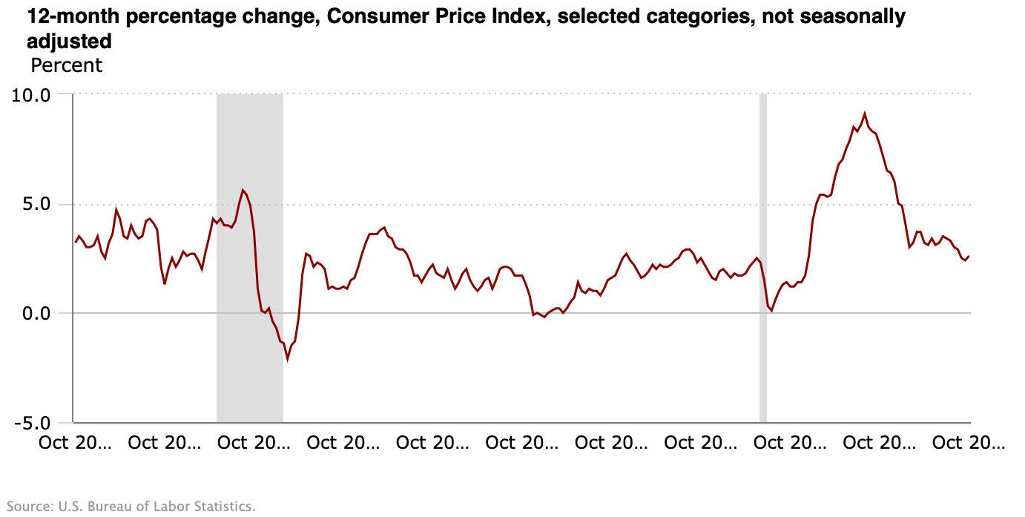

Slide 3
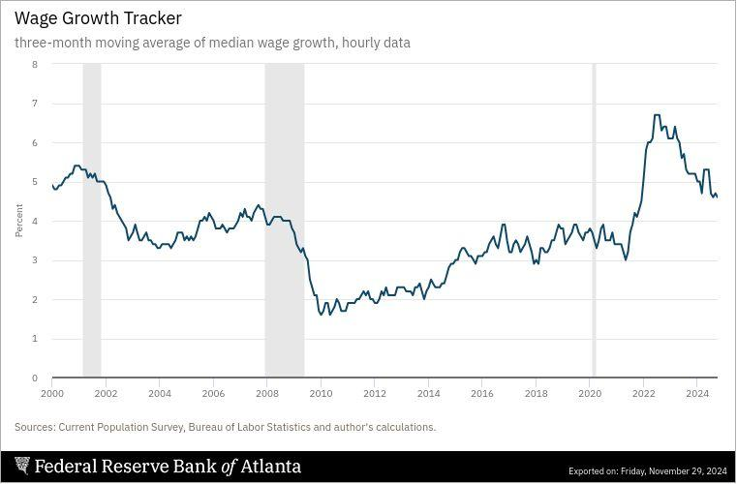

Slide 4
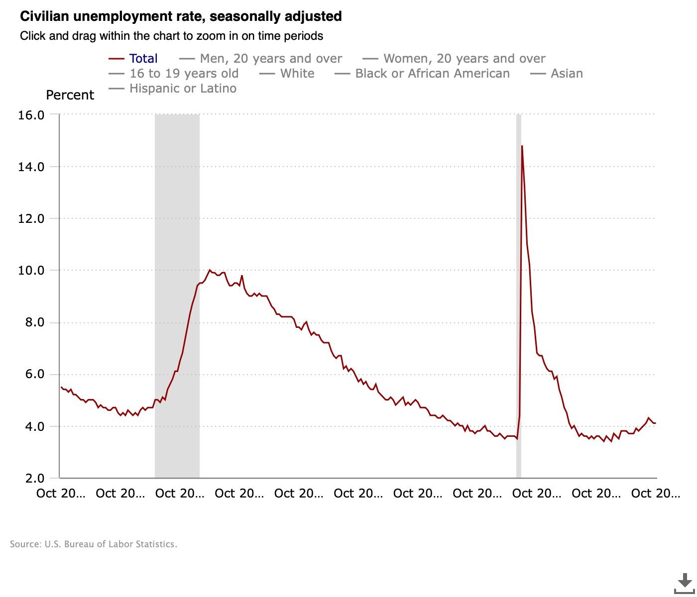

Slide 5
Background
Inflation catalysts:
  Supply chain disruptions
  Increases in minimum wage
High prices have remained persistent
  Grocery stores, gas prices, online shopping
As we all are master’s students about to enter the workforce, we wanted to look at inflation and wage growth

Slide 6
Background
Objective:
Investigate the relationship between inflation and wage growth in the U.S.
Specifically, regional disparities in wage growth
  Each region has distinct industries, immigration, tax levels, government programs
  Tech-driven Silicon Valley starkly contrasts with the manufacturing of the Midwest
How has recent inflation impacted real wage growth across the regions of the United States?

Slide 7
Background
Understanding the relationship between inflation and wage growth is crucial
If nominal wages are not keeping pace with rising prices, then real wages decline, potentially leading to decreased consumer spending, increased debt levels, and broader economic challenges
Our insights could potentially inform policymakers about regional disparities

Slide 8
Literature Review
Jaravel (2020): Found that inflation disproportionately affects low-income households, which spend a larger portion of income on necessities, making inflation’s impact on wage growth uneven across income groups.
Adjemian et al. (2023): Examined the factors behind recent inflation in the U.S., including supply chain disruptions and fiscal stimulus, highlighting the importance of these variables in understanding wage growth during inflationary periods.
Schmitt-Grohé & Uribe (2022): Investigated the impact of inflation on wage growth from 1900-2021, finding that inflation has a significant negative impact on middle-income wages, with regional differences in its effects.
Notes:
Jaravel (2020): Inflation Inequality: Measurement, Causes, and Policy Implications
Jaravel discusses how inflation affects different income groups unevenly. Lower-income households face more inflation because they spend a larger share of their income on necessities like food, energy, and housing. This research is relevant for estimating regional differences in inflation and their income effects across the U.S.
Adjemian et al. (2023): Factors Affecting Recent Food Price Inflation in the United States
Adjemian explores the causes behind the U.S. inflation surge since 2021, including supply chain disruptions, fiscal stimulus, and external shocks like the Russo-Ukrainian war. This study highlights the potential impacts of these events on inflation and could help assess their effects on wage growth, particularly with the inclusion of lagged variables like the start of the COVID lockdowns.
Schmitt-Grohé & Uribe (2022): Multiple Equilibria in Open Economies with Collateral Constraints
This study investigates the dynamics of inflation from 1900 to 2021, emphasizing the permanent component of inflation. Schmitt-Grohé and Uribe examine how inflation affects wage growth, particularly in the context of middle-income households, whose wages have not kept up with inflation’s rising costs. The study also highlights regional differences in inflation's effects, making it particularly relevant for understanding the varying rates of wage growth across U.S. regions.
Relevance to Our Study:
Our analysis builds on these findings by exploring the specific impacts of inflation and unemployment on wage growth across different U.S. regions. The literature highlights significant regional disparities, and this research aims to provide deeper insights into how inflation and unemployment influence wage dynamics at the regional level. This understanding will be essential for developing targeted economic strategies to mitigate the adverse effects of inflation on wage growth.

Slide 9
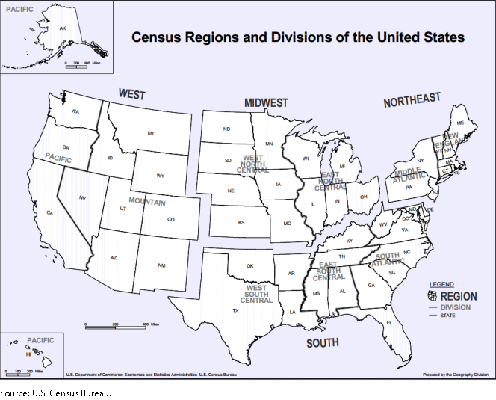
Data
Region 1: Northeast
  Division 1: New England (Connecticut, Maine, Massachusetts, New Hampshire, Rhode Island, and Vermont)
  Division 2: Middle Atlantic (New Jersey, New York, Pennsylvania, and Maryland)
Region 2: Midwest (designated as the North Central Region before June 1984)
  Division 3: East North Central (Illinois, Indiana, Michigan, Ohio, and Wisconsin)
  Division 4: West North Central (Iowa, Kansas, Minnesota, Missouri, Nebraska, North Dakota, and South Dakota)
Region 3: South
  Division 5: South Atlantic (Florida, Georgia, North Carolina, South Carolina, Virginia, Washington, D.C., Delaware, and West Virginia)
  Division 6: East South Central (Alabama, Kentucky, Mississippi, and Tennessee)
  Division 7: West South Central (Arkansas, Louisiana, Oklahoma, and Texas)
Region 4: West
  Division 8: Mountain (Arizona, Colorado, Idaho, Montana, Nevada, New Mexico, Utah, and Wyoming)
  Division 9: Pacific (Alaska, California, Hawaii, Oregon, and Washington)
Notes:
Geoff

Slide 10
Data
  Real Wage Growth: Monthly real regional wage growth (Federal Reserve Bank of Atlanta)
    Nominal wage percent change: 100*ln(Wage_{t} / Wage_{t-12})
    Real wage: nominal wage - inflation
  Unemployment Rate: Monthly unemployment data by region (U.S. Bureau of Labor Statistics)
  GDP Data: Monthly U.S. GDP data (S&P Global)
  Consumer Price Index (CPI): Regional inflation data (U.S. Bureau of Labor Statistics)

Slide 11
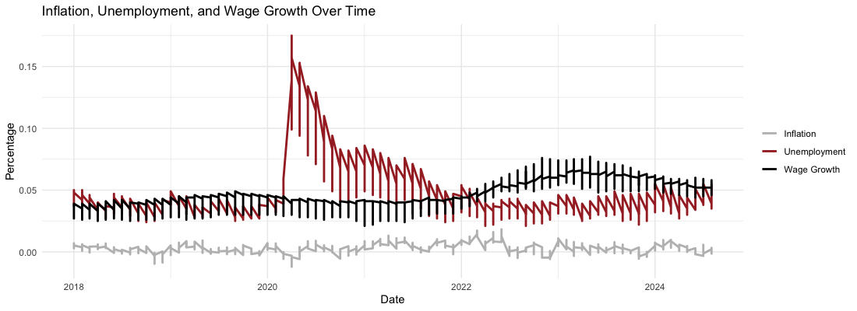
Exploratory Data Analysis (EDA)
Notes:
Exploratory Data Analysis (EDA)
Inflation, Unemployment, and Wage Growth Over Time:
Visualization: Line chart showing trends in inflation, unemployment, and wage growth.
Key Insights:
Inflation spikes during periods of economic crisis.
Unemployment rates vary significantly across regions, influencing wage growth.
Wage growth shows cyclical patterns based on economic conditions.

Slide 12
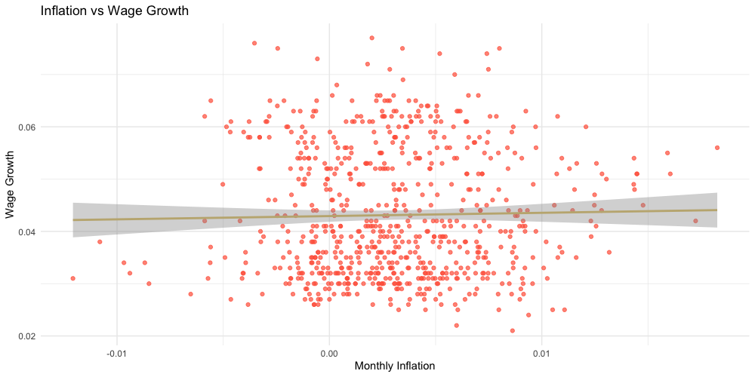
Exploratory Data Analysis (EDA)
Notes:
Inflation vs Wage Growth:
Scatter Plot: This plot shows the correlation between inflation rates and wage growth across time.
Insight: Negative relationship between inflation and wage growth across time.

Slide 13
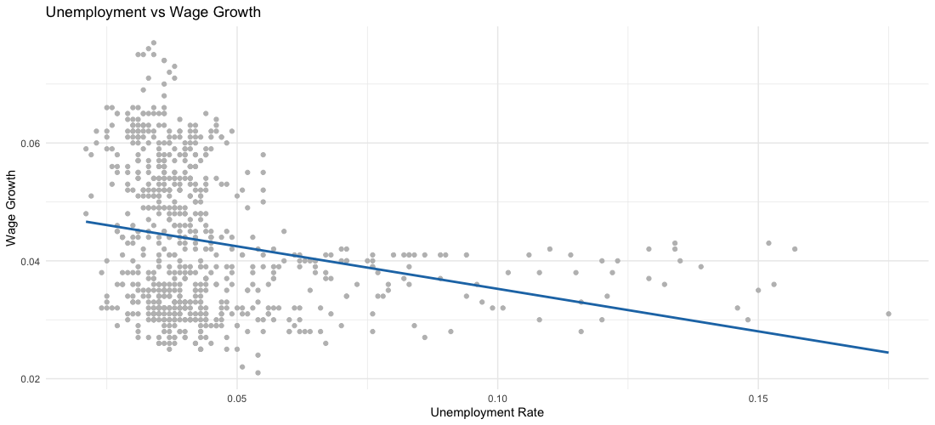
Exploratory Data Analysis (EDA)
Notes:
Insight: Higher unemployment correlates with lower wage growth.

Slide 14
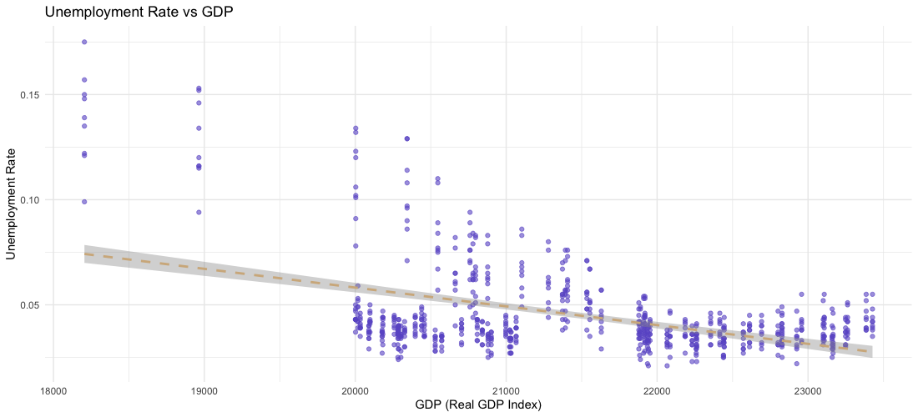
Exploratory Data Analysis (EDA)
Notes:
Unemployment Rate vs GDP:
Line Graph: graph explores the inverse relationship between unemployment and GDP growth.
Key Insight: Higher unemployment often correlates with economic contractions (lower GDP).

Slide 15
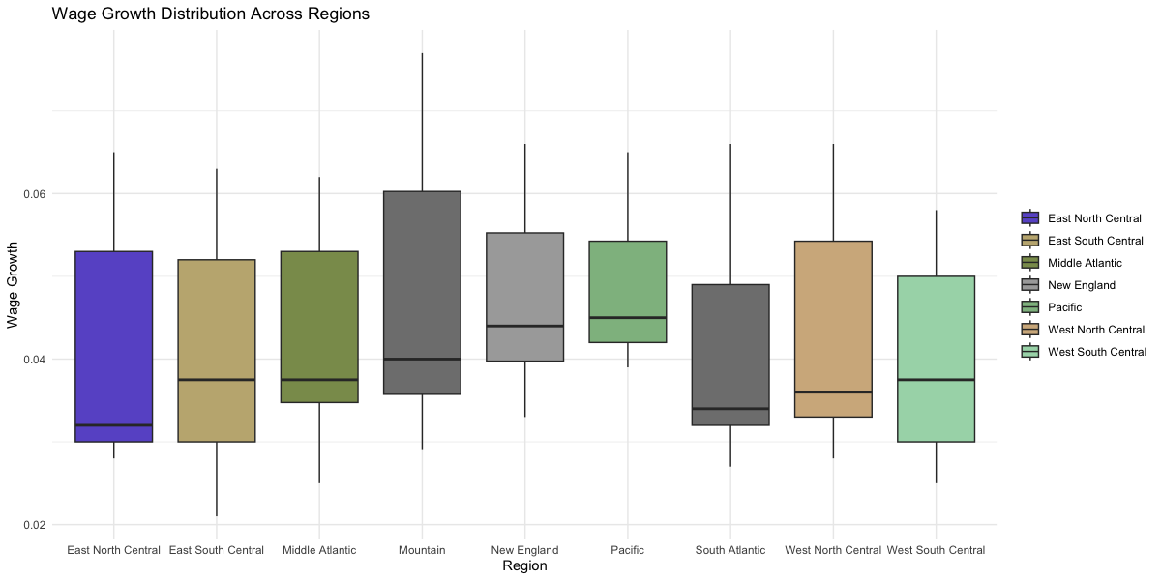
Exploratory Data Analysis (EDA)

Slide 16
Key Findings from EDA
Unemployment and Wage Growth: A negative relationship was found between unemployment and real wage growth. As unemployment rate increases, wage growth tends to stagnate or decline.
Unemployment Rate and GDP: The relationship between unemployment and GDP was inverse. Higher unemployment generally leads to lower GDP, and vice versa.
Regional Wage Disparities: Some regions (e.g., West Coast and Northeast) experienced faster wage growth, while others (e.g., South and Midwest) lagged behind.

Slide 17



Regression Model: Fixed-Effects
We will be estimating the following model,:
via Fixed-Effects OLS,:
due to the following assumptions:
Notes:
In order to study the relationship between wage growth and inflation we employ a fixed effects estimator. This estimation method is ideal as it allows us to exploit the variation within each region over time to control for factors that do not change over time. It is also a consistent estimator for short panel data which is what we have at our disposal. One downside is we are unable to measure the effect of variables that do not change overtime in this set up. As a result, our region specific dummy variables cannot be estimated. This is not a problem as those variables are a nuisance to us we are not concerned with them.
The first assumption is key as it simply says that the unobserved factors that do not change are not correlated with our control variables. This is an realistic assumption as certain policies or industries that are persistent and affect our macro variables will violate the opposite claim easily ie equality. The second is the zero conditional mean assumption which is essential to all empirical work as it prevents biased estimates.

Slide 18
Regression Model: Fixed-Effects
Y is log monthly real wage growth by region
X is a vector representing the following controls:
Monthly inflation by region
log Unemployment by region
log US population
log Real GDP of the US (S&P Index)
Post 2020 dummy variables
Region dummy variables
Interaction between inflation and region
Interaction between post 2020 and inflation
Interaction between region and unemployment
The betas related to the bolded are the focus of our research
Notes:
real wage growth we calculated ourselves
The betas related to the bolded are the focus of our research.

Slide 19
Model Coefficients Interpretation
A 1 percentage point change in monthly inflation is associated with a 0.18% decrease in real wages in the Pacific region (California, Oregon, Washington, Hawaii, Alaska)
The regions that are most negatively affected by inflation are:
  East South Central (0.321%) (Alabama, Kentucky, Mississippi, and Tennessee)
  South Atlantic (0.284%) (Florida, Georgia, North Carolina, South Carolina, Virginia, Washington, D.C., Delaware, and West Virginia)
  West South Central (0.228%) (Arkansas, Louisiana, Oklahoma, and Texas)
Effect of inflation on real wages did not change after 2020. While our model says that on average the effect is 0.04% stronger across all regions, it is also not statistically significant at any commonly used significance level (5%, 10% etc).
Notes:
Generally in our results, states that rely more on agriculture than the services industries were more affected by inflation.
Our original model had found no structural breaks.

Slide 20
Validity Check (Post 2020)
Original Post 2020 dummy variable is coded as 0 pre Jan 1 2020 and 1 afterwards
We run two additional regressions with the dummy variable designed differently, setting the cutoff dates to
  July 1 2020
  Jan 1 2021
This will help us check for structural breaks.
Notes:
We repeated the regression while changing the start point of the Post 2020 dummy variable in order to cross check our results

Slide 21
Validity Check (Post 2020)
We now see evidence of a structural break. The effect of inflation on real wages was exacerbated, on average, after COVID-19
  July 1 2020 Cutoff Estimate: 0.06%
  Jan 1 2021 Cutoff Estimate: 0.07%
Both are significant at the 5% level.
Ranking of effect of inflation on wages between regions does not change.
Notes:
So the list of regions most affected by inflation did not change in our model which further validates are results.

Slide 22
Conclusion
Inflation negatively impacts real wage growth across all regions, especially during high inflation periods.
Unemployment levels directly affect real wage growth
Regional disparities persist in real wage growth
Notes:
Conclusion and Recommendations
Conclusion:
Inflation negatively impacts wage growth across all regions.
Unemployment is a key factor in wage stagnation, with regional variations.
Fixed-effects model highlights the need for region-specific economic policies.
Recommendations:
Targeted interventions for regions experiencing high unemployment.
Address inflation through monetary policies to boost wage growth.

Slide 23
Policy Implications
  Targeted regional policies for those low-performing regions.
  Modify inflation control policies to minimize the impact of inflation on real wage growth.
  Invest in regions with persistent high unemployment level to foster economic growth.
  Policy coordination across levels of government

Slide 24
Limitations of the Study
Time constraint and limited observations.
  Post 2020 analysis limited to a relatively short time frame, difficult to assess longer-term impacts or distinguish between temporary/permanent changes.
Lack of explanation for the regional disparities (e.g., regional economic structures, dominant industries, policy environments, immigration)
Economic structure variability
Exclusion of non-monetary compensation (e.g. healthcare, pensions)
Notes:
Conclusion and Recommendations
Conclusion:
Inflation negatively impacts wage growth across all regions.
Unemployment is a key factor in wage stagnation, with regional variations.
Fixed-effects model highlights the need for region-specific economic policies.
Recommendations:
Targeted interventions for regions experiencing high unemployment.
Address inflation through monetary policies to boost wage growth.

Slide 25
Next Steps
Continue refining the model by adding more macroeconomic variables (income differences between regions, economic structures variables), incorporate more data, make deeper analysis of regional disparities and the post-2020 study.
Find sectoral impacts. examine how inflation and wage dynamics differ across industries within regions to refine policy recommendations further.
Study the long-term consequences of inflation on wage growth and employment trends to guide sustained policy interventions.
Notes:
Conclusion and Recommendations
Conclusion:
Inflation negatively impacts wage growth across all regions.
Unemployment is a key factor in wage stagnation, with regional variations.
Fixed-effects model highlights the need for region-specific economic policies.
Recommendations:
Targeted interventions for regions experiencing high unemployment.
Address inflation through monetary policies to boost wage growth.

Slide 26
References
https://www.statista.com/statistics/1351276/wage-growth-vs-inflation-us/
https://data.bls.gov/dataViewer/view/timeseries/CUSR0000SA0
https://www.atlantafed.org/chcs/wage-growth-tracker
https://fred.stlouisfed.org/series/POPTHM
https://www.spglobal.com/marketintelligence/en/mi/products/us-monthly-gdp-index.html#:~:text=We%20calculate%20the%20MGDP%20in,our%20archives%20of%20the%20MGDP.
https://www.bls.gov/opub/mlr/2023/beyond-bls/what-caused-inflation-to-spike-after-2020.htm
https://www.bls.gov/cpi/
https://www.ilo.org/resource/news/rising-inflation-brings-striking-fall-real-wages-ilo-report-finds

Slide 27
Thank you!

